Slide 1

H172 35 - Object Oriented Analysis and Design
OOP Zoo Shop Initial Class Diagram Example

Slide 2
OOP Zoo Shop CRC Cards

Slide 3
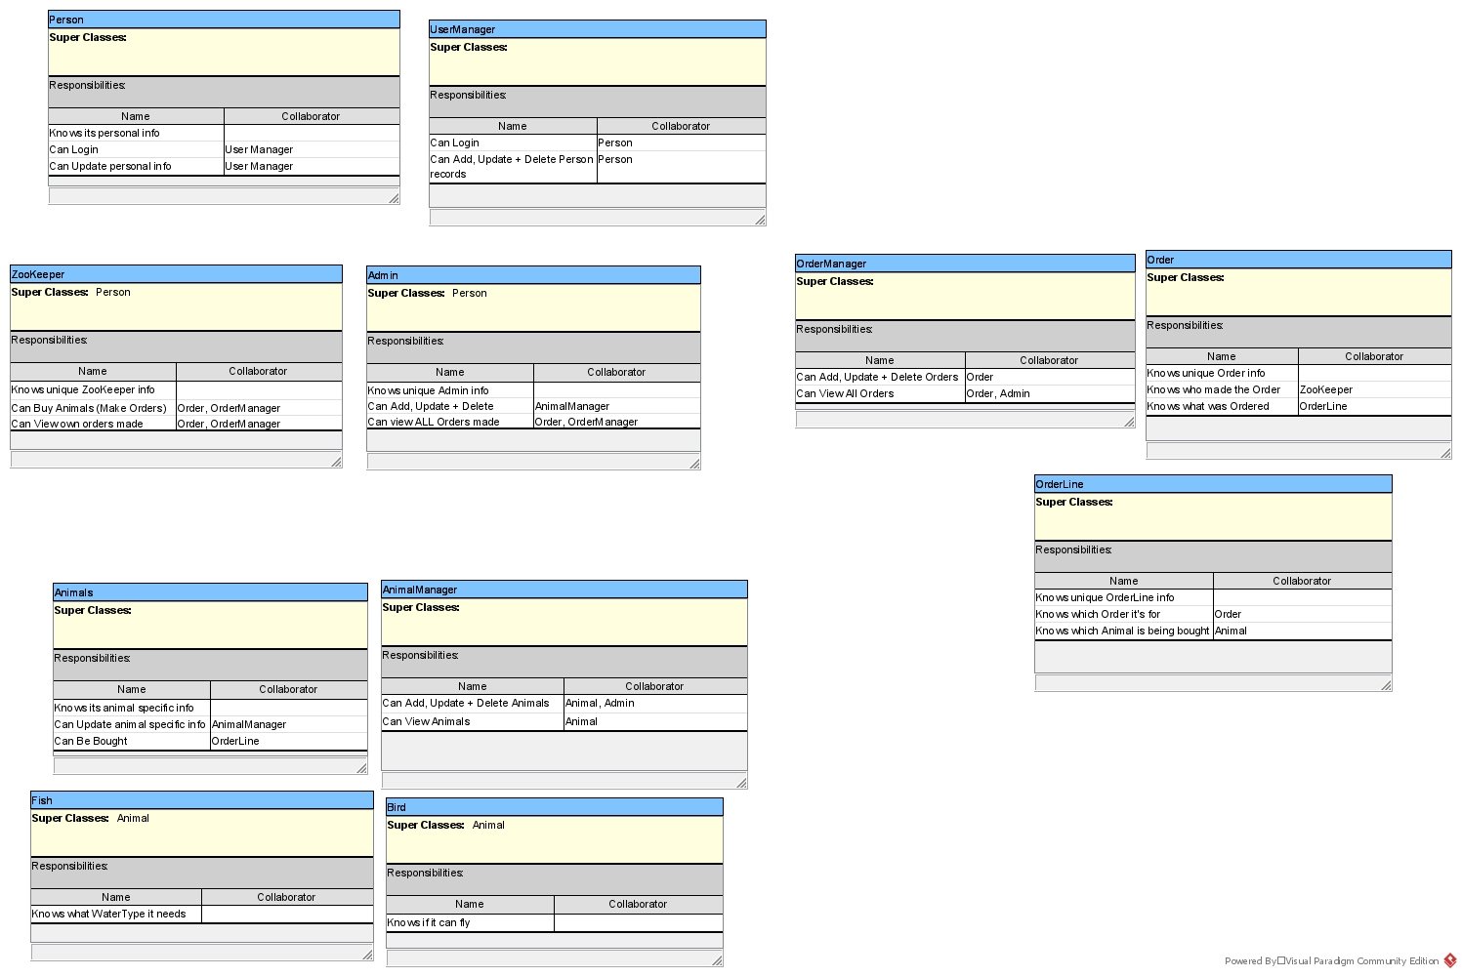

Slide 4
OOP Zoo Shop Initial Class Diagram

Slide 5
Step 1 Create Classes from CRC cards

Slide 6
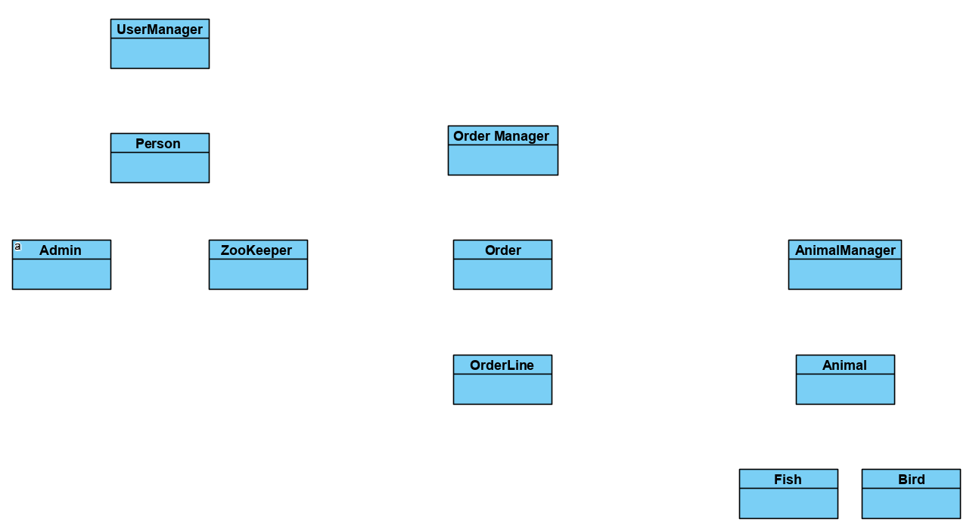

Slide 7
Step 2 * Check for missing classes * Rename where necessary

Slide 8
All Classes Present and well named
Who knew??!!
It’s almost as if I stole the design from what James is doing with you in OOP…

Slide 9
Step 3 Draw Inheritance

Slide 10
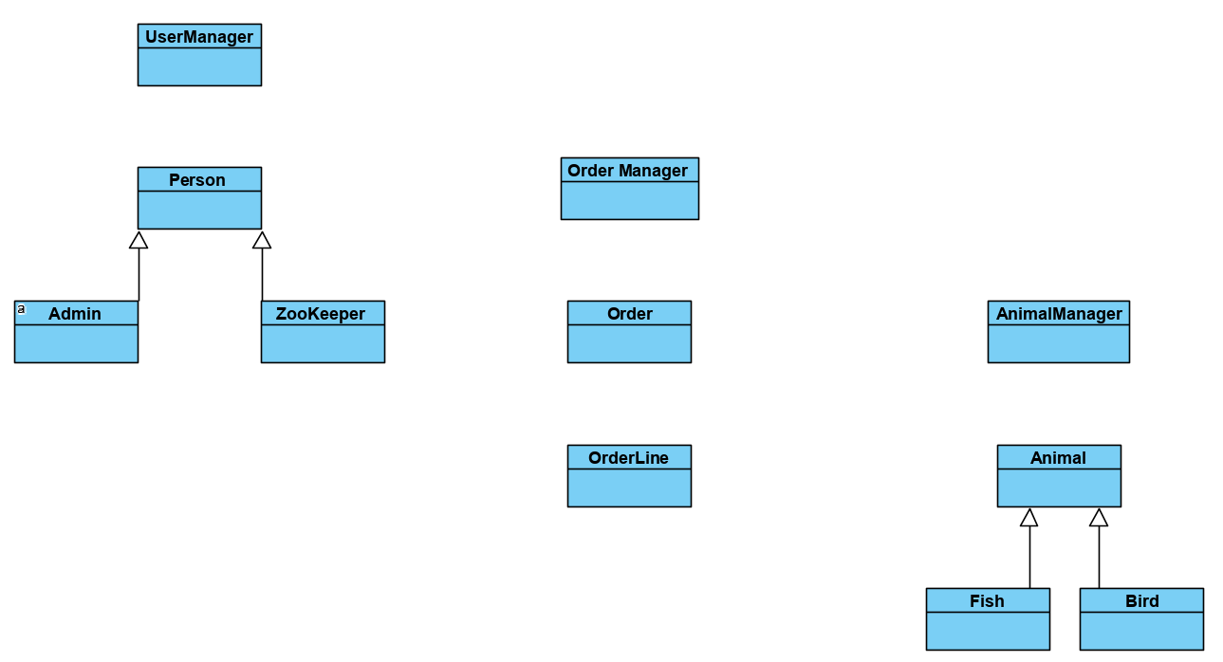

Slide 11
Step 4 Draw + Name Association

Slide 12
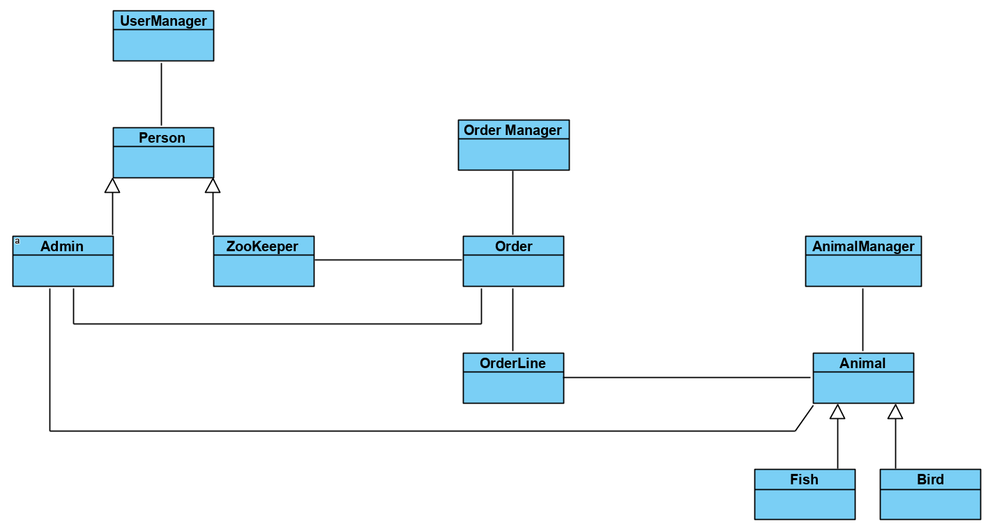


Manages
Manages
Makes
Contains
Manages
Buys

Slide 13
Step 5 Identify Aggregation / Composition

Slide 14
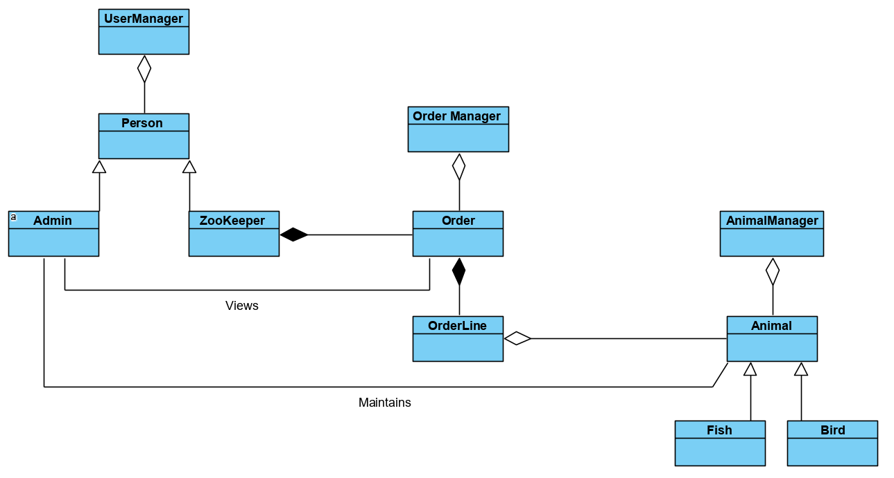
Notice I’ve removed naming of Aggregation + Composition
This is because naming these is optional

Slide 15
Step 6 Detail Multiplicity

Slide 16


